Slide 1

PowerTeacher Pro
Accountability Department
Teaching & Learning Conference
August 2017
WE ARE Gaston County Schools

Slide 2
Agenda
What is different this year?
Logging in and launching gradebook
Review the charms on the left hand-side of gradebook
Viewing student grades, assignments and demographics
District setup
  Middle/High (Category - locked/Weights -Update)
  Elementary(Category - Update/Weights -Locked)
Adding Grades and working with Score Inspector
Viewing Student and Class Progress
PowerTeacher Pro Reports
WE ARE Gaston County Schools
WE ARE Gaston County Schools

Slide 3
What is different?
  What is different this year?
    Full functionality from any computer or tablet, including: Mac, Windows, iOS, Android and Chromebooks.
    Performance and Stability has increased across platforms (including mobile devices)
    LEA/district will have categories available but will need to be adjusted for courses as necessary
    District categories will be pushed down by LEA/district to teachers’ gradebooks
WE ARE Gaston County Schools
WE ARE Gaston County Schools

Slide 4
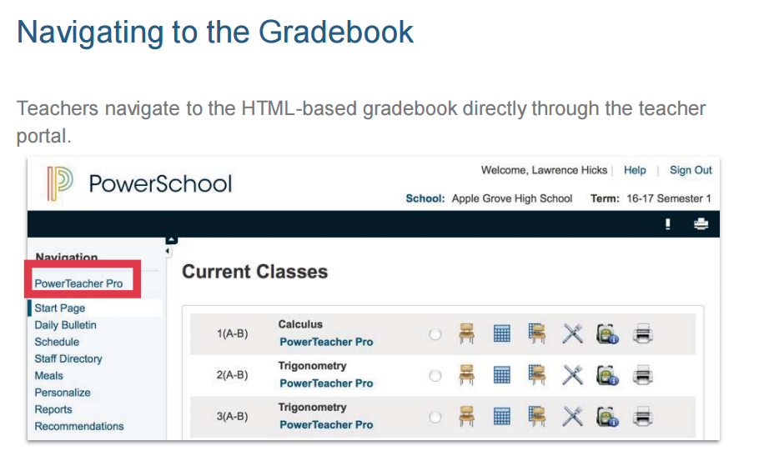
PowerTeacher Pro
WE ARE Gaston County Schools
WE ARE Gaston County Schools

Slide 5

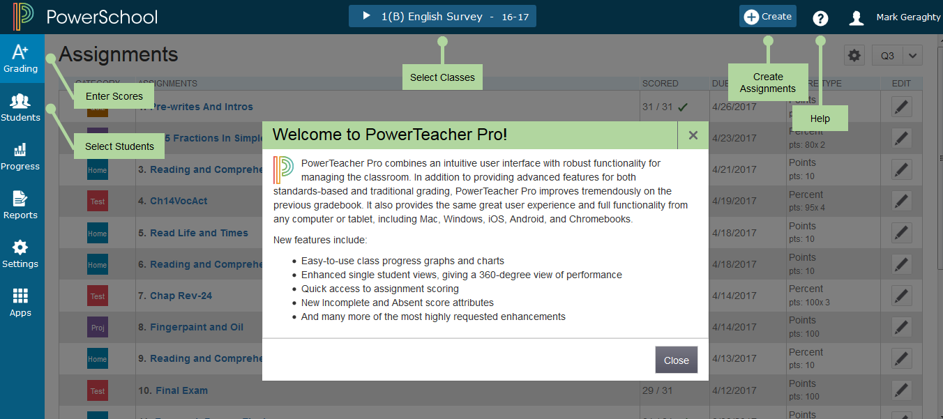
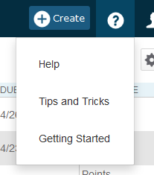
PTPro Help
Notes:
The first time teachers access PTPro they will see this Welcome Message. ….. Click Close.
Robust Help feature - Click on Question mark > clicking Getting Started will show the welcome and navigation bubbles again
Getting Started -- available on several pages- shows navigation bubbles
Tips and Tricks -- (opens in new window) Accessibility View, Show/Hide Page Elements, Scroll Bars Invisible, Reports, Associate Assignments, Save Toner When Using Print Screen and Printing Report, Hot Keys
Help - (opens in new window) Welcome, Table of Contents, Index, Search

Slide 6
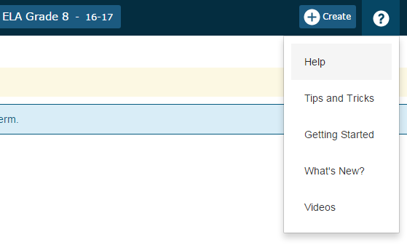
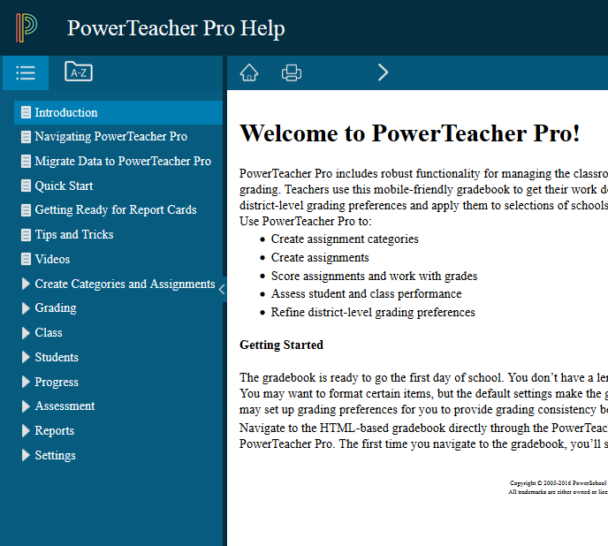
PTPro Help
Notes:
Help - There is access to generic PTPro training videos
Getting Started -- available on several page- shows navigation bubbles
Tips and Tricks -- (opens in new window) Accessibility View, Show/Hide Page Elements, Scroll Bars Invisible, Reports, Associate Assignments, Save Toner When Using Print Screen and Printing Report, Hot Keys
Help - (opens in new window) Welcome, Table of Contents, Index, Search

Slide 7

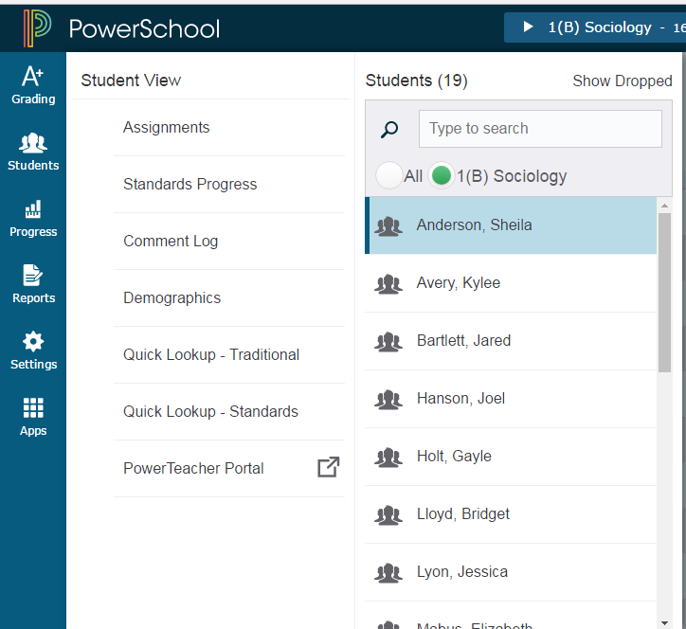
Students Charm
View student progress,
Manage communication,
Work with assignments.
Notes:
-defaults to current class at the top of page
Analyze performance throughout the term to ensure that students are mastering the skills and standards you are teaching. Review students’ performance as you prepare to complete final grades for report cards, and then use the gradebook to prepare for and conduct parent-teacher conferences.
Other pages in PowerTeacher Pro are optimized to display how an entire class is performing using the Progress pages. The individual student pages, however, provide more detailed information on an individual student. This is particularly useful for entering multiple of scores for a single student, and during parent-teacher conferences to explain why a student earned a particular grade.
On the charms bar, select Students.
Search for a student using the search field. Use the selection buttons to limit the search to a class or all classes for the teacher.
Select a Student View from the menu. The details for the student highlighted in the Students list appears.
Use the Quick Menu to navigate to other pages in the Students section of PowerTeacher Pro.
To view only dropped students, select Show Dropped.
Select a student name to view details for that student.

Slide 8
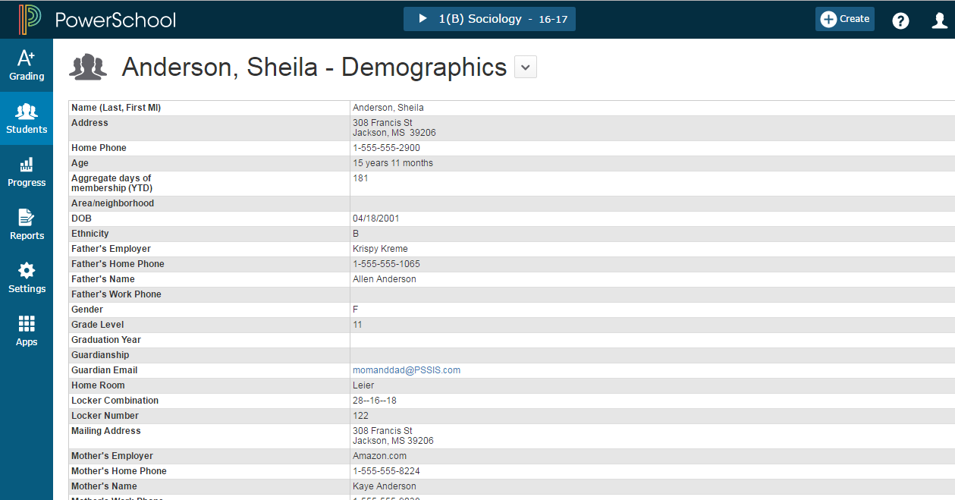
Students Views
> Demographics
Notes:
This page shows the student demographic information as entered in PowerSchool.
On the charms bar, select Students, and then select Demographics.
Use the Quick Menu links (the arrow next to the page heading) to navigate to other pages in the Students section of PowerTeacher Pro.
Notes: Currently Teachers cannot add additional columns like they can in PTG.
Student Emails do not populate to this demographics screen.

Slide 9
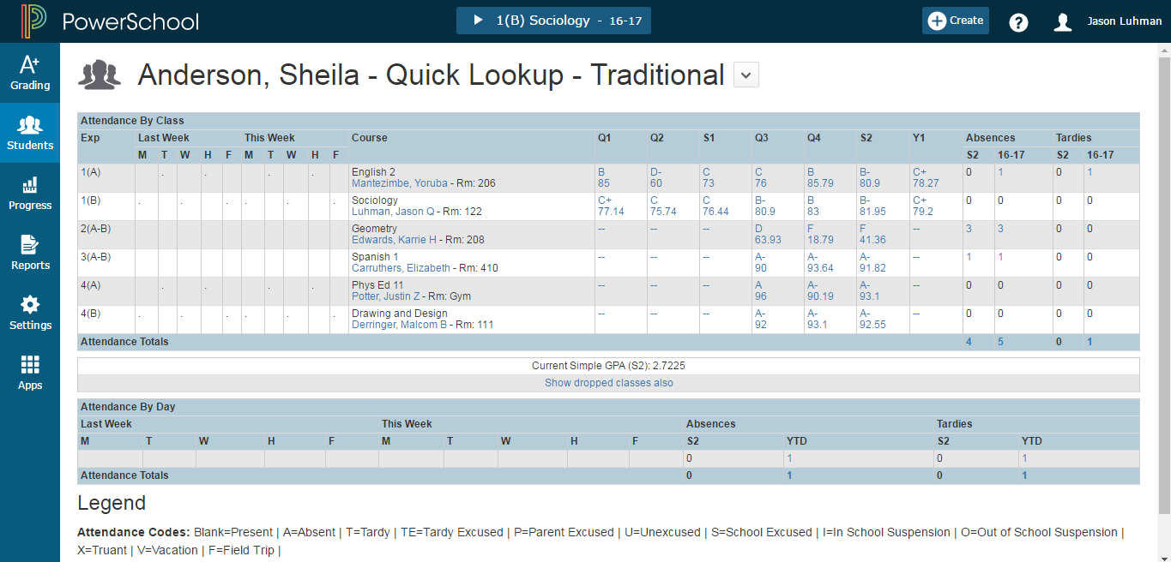
Quick Lookup - Traditional
Notes:
Quick look up screen=parent portal screen!!
-Snapshot of last two weeks of attendance; blanks mean present, dots in box means that class did not meet that day (elementary does not get dots)
-Course
-Terms
-Attendance information

Slide 10
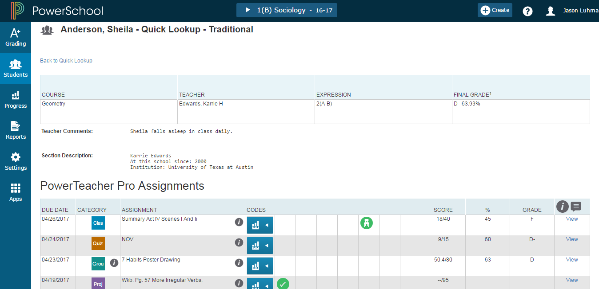
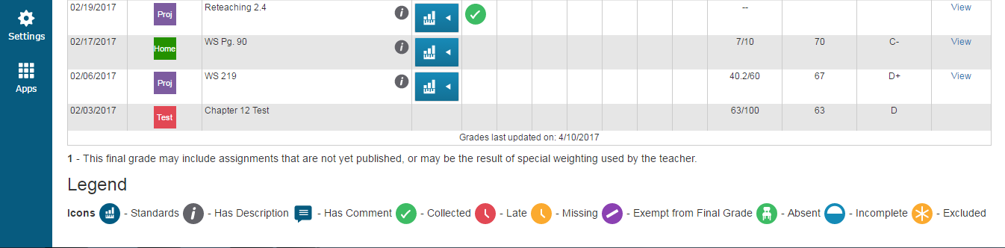
Score Detail
Notes:
Click on grade to see more info
-Teacher comments
-Section description
-”I” icon means you can view more info on the right
-”Grid” icon- you can see standards on that assignment;if you collapse the standards you can see them in more detail. (parent)
Comment symbol is in the view area
-view will give you up to 3 tabs
-boxes to identify what has been flagged

Slide 11
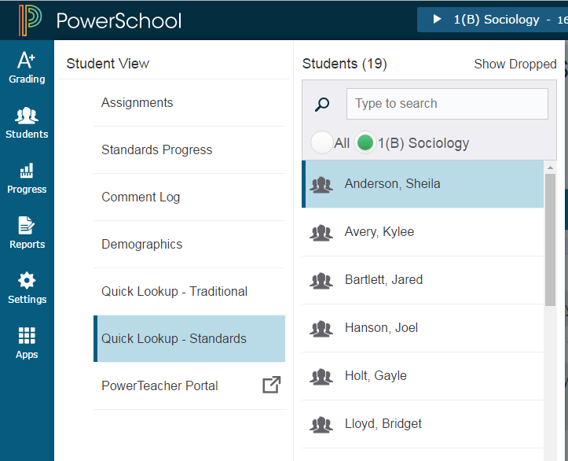
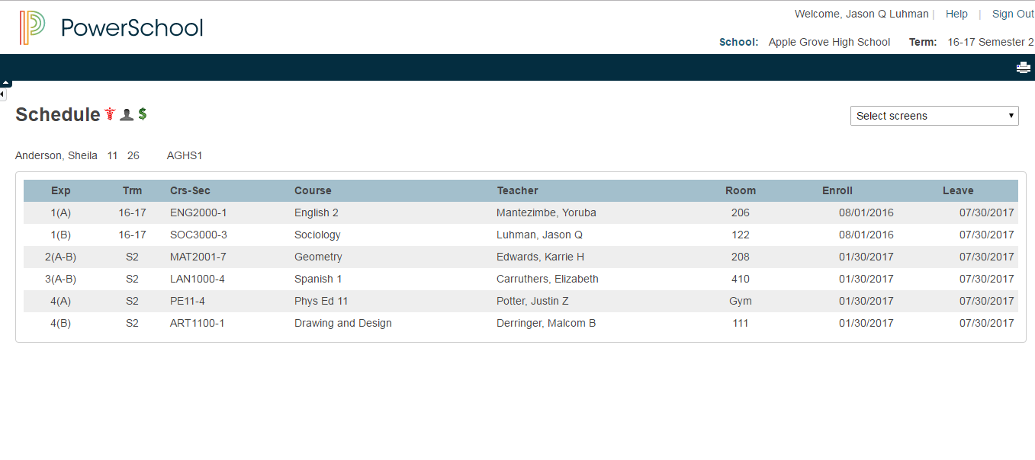
Students > PowerTeacher Portal
Notes:
PT Portal link from a student’s page will drop you into that student’s back pack
-use select screens for more info
PT Portal link from the ‘Apps’ charm will drop you into the main page of PowerTeacher Porta.

Slide 12





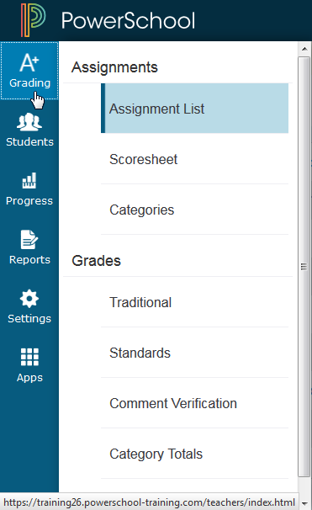
PTPro Charms - A+ Grading
A+ Grading Charm
Teachers spend most of their time here.
  Usually in Assignments
  Grades - for end of year reporting (can set up traditional and standard grades)
Students Charm
Progress Charm - Track class progress, standards
Reports Charm
Settings Charm
Apps Charm - link to PTPortal
    More on these later...
Notes:
Charms on left-hand side of the page
A+ grading charm- teachers spend most of their time here
-usually in Assignments
-grades for end of year reporting (can set up traditional and standard grades)
Student charm can choose a set of students
Progress charm=track class progress, standards
Reports
Settings
Apps-link to PTPortal

Slide 13
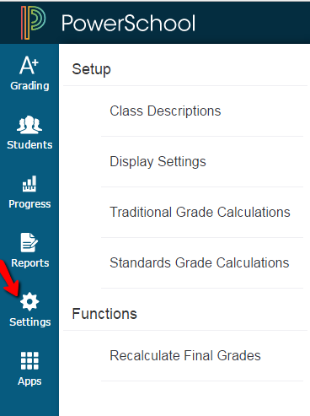
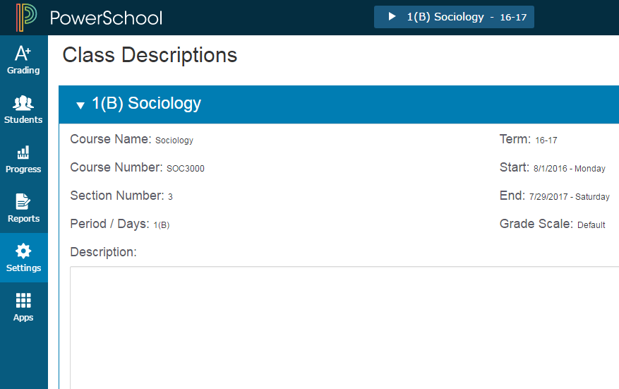
PTPro Charms - Settings > Class Descriptions
Description shows in the
Parent and Student Public Portal
  no character limit
Notes:
Navigate to Settings Charm
Class Descriptions (Description of course): This is displayed for the parent and student in the public portal
-no character limit
-can add links via html code: will get click a button in the future
-can add in class syllabus info
Note: Grade Scale is a new name in PS 10, called letter grade in PS 9

Slide 14
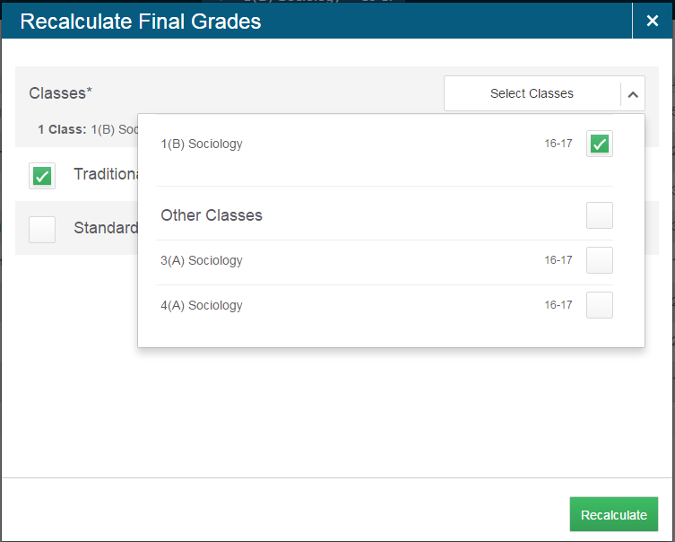
PTPro Charms - Settings > Functions
Options for Traditional or Standards
AND which classes you want to recalculate.
Notes:
Settings Charm
Functions
Recalculate final grades: you have the option for traditional or standards AND which classes you want to recalculate

Slide 15
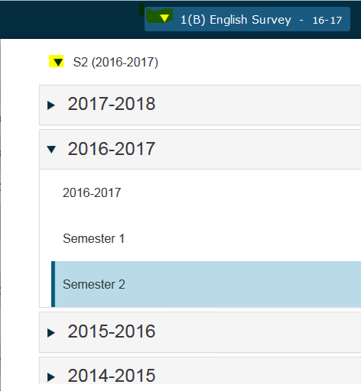
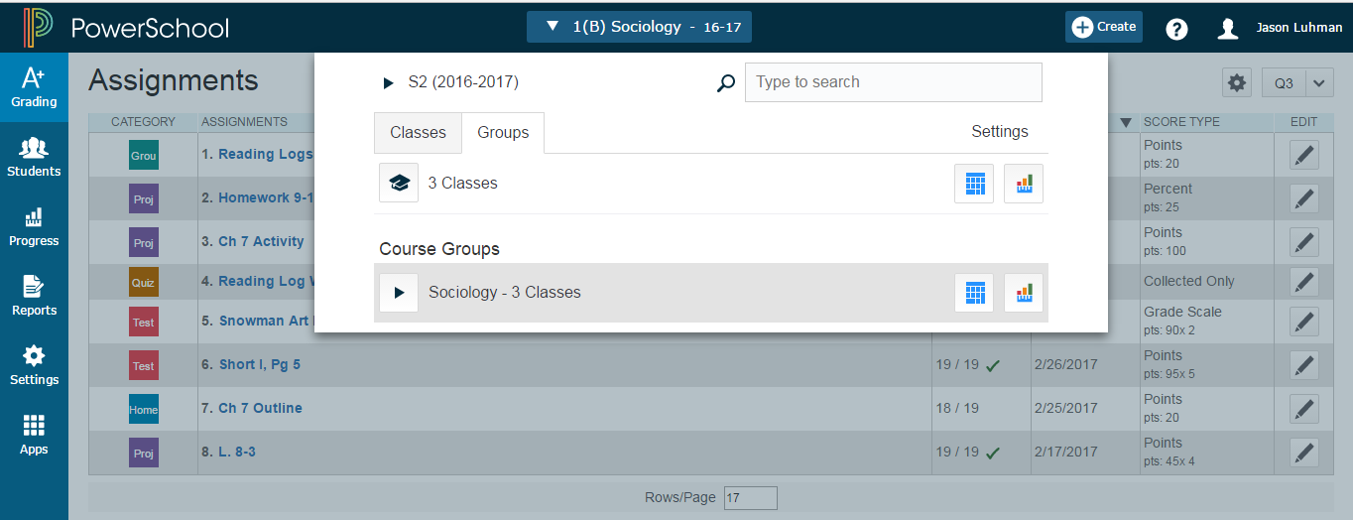
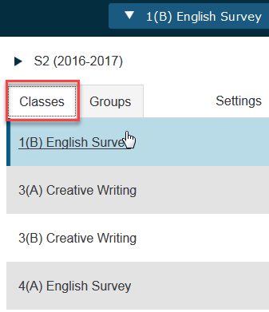
Navigating Classes
Classes - Click Blue Class Button > Classes Tab > pick class to view
Groups - Click Blue Class Button > Groups Tab > Pick group to view all students in that group. Right now, in PT Pro there is no ability for teachers to create groups. Feature is coming in a future release.
Notes:
Classes - Choose from blue button, shows all terms , will show next year term when created in PowerSchool.
Groups
Right now, in PT Pro there is no ability for teachers to create their own groups. This feature is coming in a future release.

Slide 16
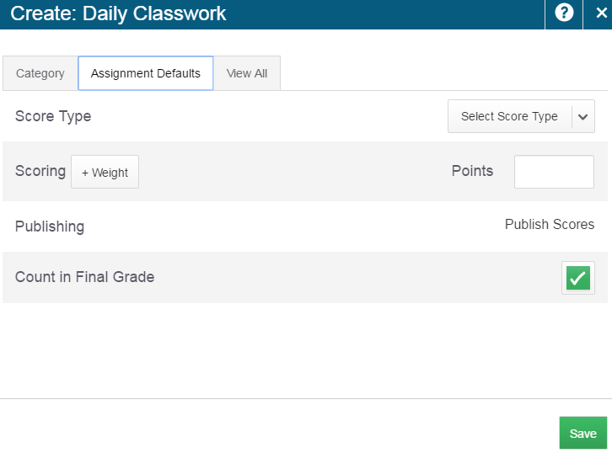
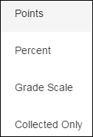
Creating Categories - Assignment Defaults Tab
By Default this is set to POINTS - options under Select Score Type drop down
Notes:
Assignment Defaults-how you want stuff to be scored
Points is the default - even before you choose a score type
Collected only for standards based grading
Can weight grades and add bonus points
Publishing will be done in assignment if needed

Slide 17
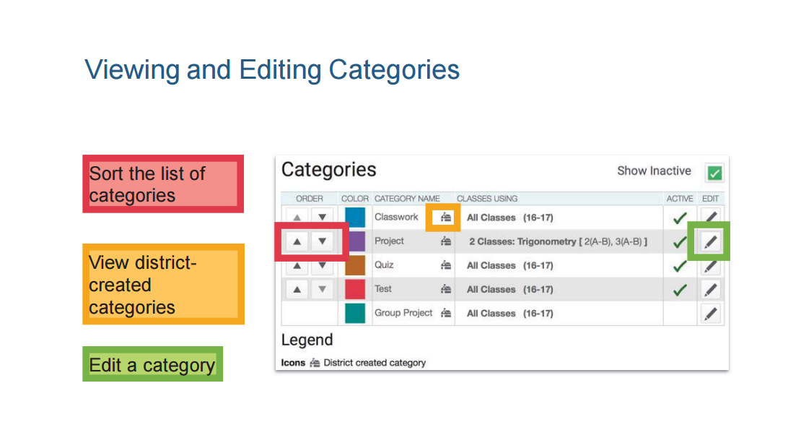
  NOTE: Teachers can still create their own categories. However, those categories will not factor in the overall final grade calculation.
WE ARE Gaston County Schools
WE ARE Gaston County Schools

Slide 18
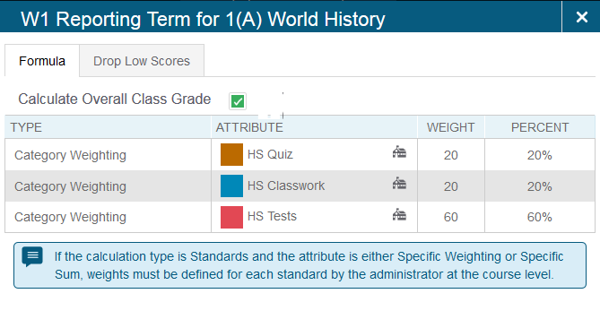
HS Traditional Categories

Slide 19
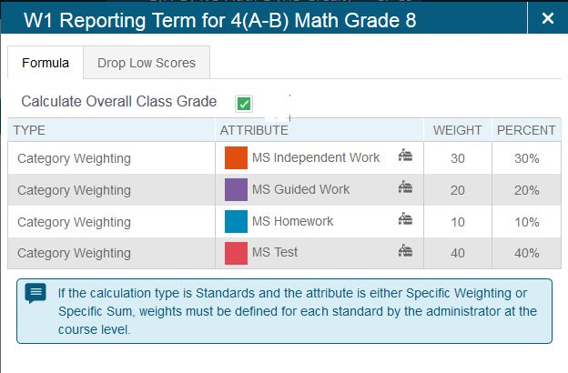
MS Traditional Categories

Slide 20
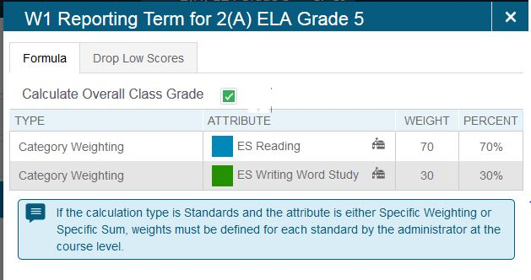
ES Categories Grades 3-5

Slide 21
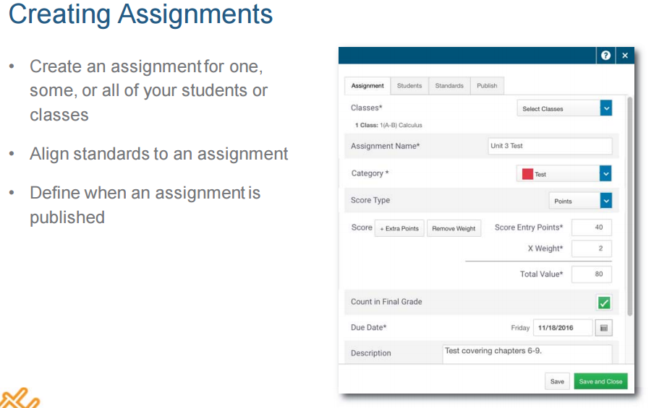
WE ARE Gaston County Schools
WE ARE Gaston County Schools

Slide 22

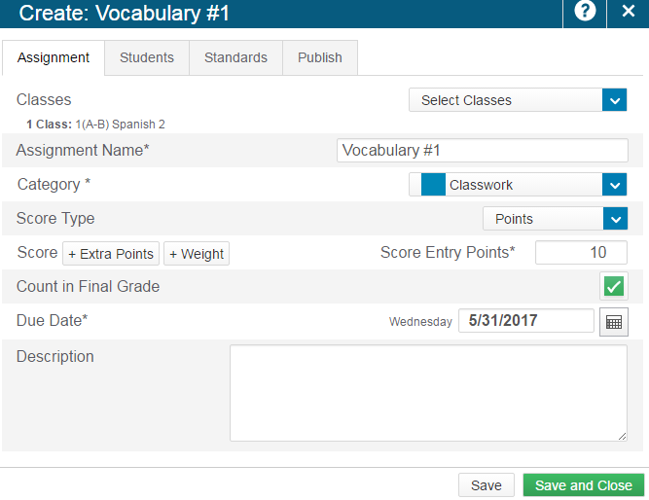
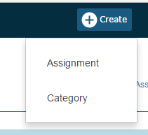
Create an Assignment
Notes:
Create>Assignment
-can override category default on assignments
-choose due date (populates to today if not changed)
-if multiple classes, can set multiple dates using +Per Class button
Create assignment once across all classes --- creates a shared anchor point
When duplicate or copy assignments --- creates individual anchor points
Caution if deleting an assignment with a shared anchor point - all connected assignments in all classes will be deleted whether scored or not. Advised to edit the assignment instead of deleting and deselect (uncheck) the Class that no longer needs this assignment.

Slide 23
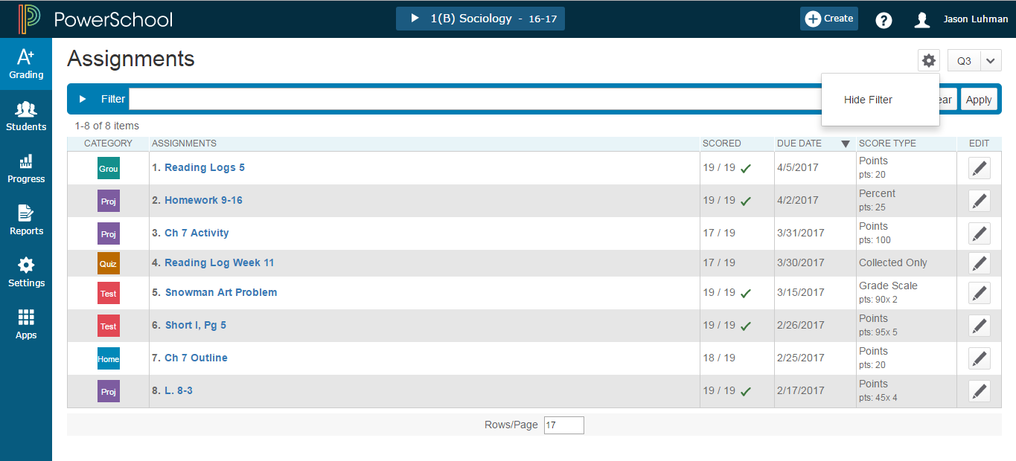
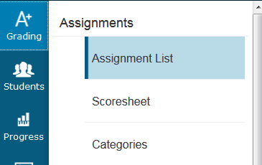
Working with Assignments
Lists assignments in chosen term
Shows Category and link to assignment
Sort columns by clicking on the column titles
Checked means all students have submitted the assignment
Notes:
Can show and hide filter
-list assignments in that term
-category and link to assignment
-sortable columns
-Checked means all students have submitted the assignment
23/23--23 assignments marked out of 23 students

Slide 24
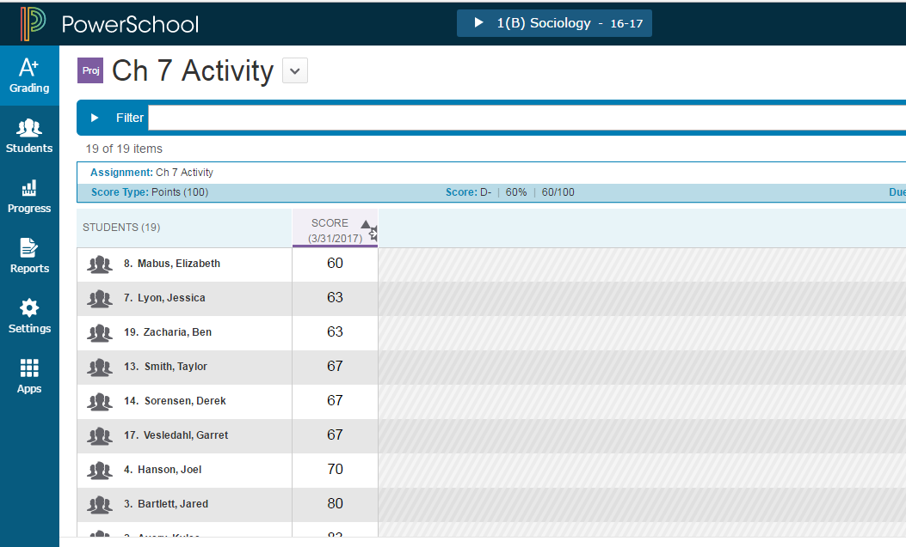
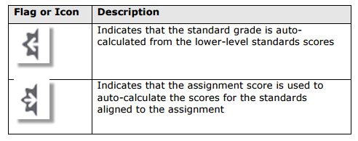
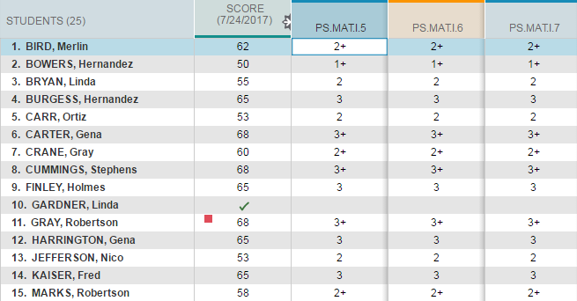
Assignment List
Can click on
hyperlinked names
Push Notification (auto-calculate) on score to or from Standards
Columns can be sorted
Notes:
Clicked assignment
Can click on hyperlinked names
-push notification on score
Can be sorted
You can select if you want the assignment score to auto-calculate the standards scores. 1. Select an assignment name on the Assignments page or the Scoresheet. 2. On the Standards tab of the Edit Assignment dialog, select the checkbox if you want the assignment score to auto-calculate to standards scores.

Slide 25
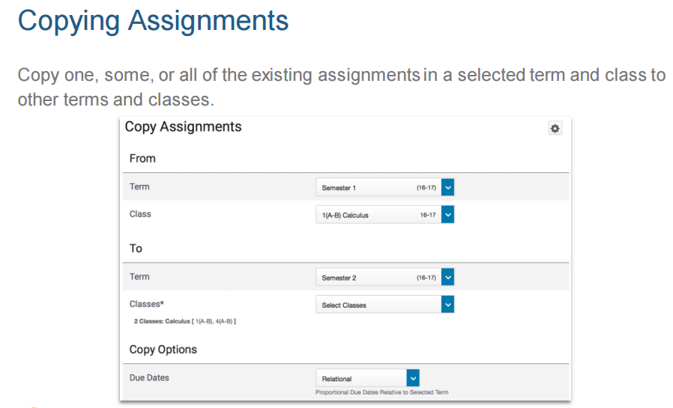
*
WE ARE Gaston County Schools

Slide 26
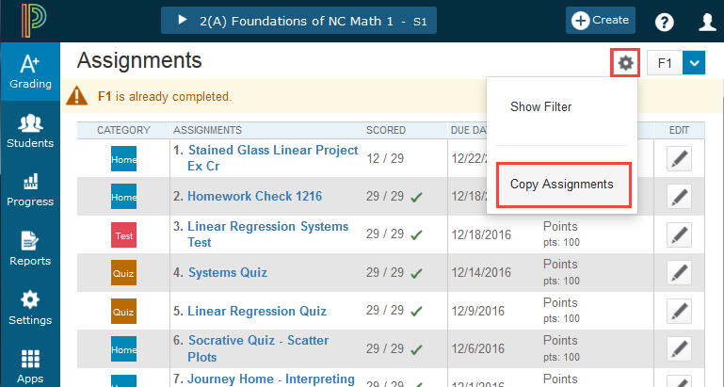
Copying an Assignment
Notes:
Copy function is found in the ‘Gear’

Slide 27
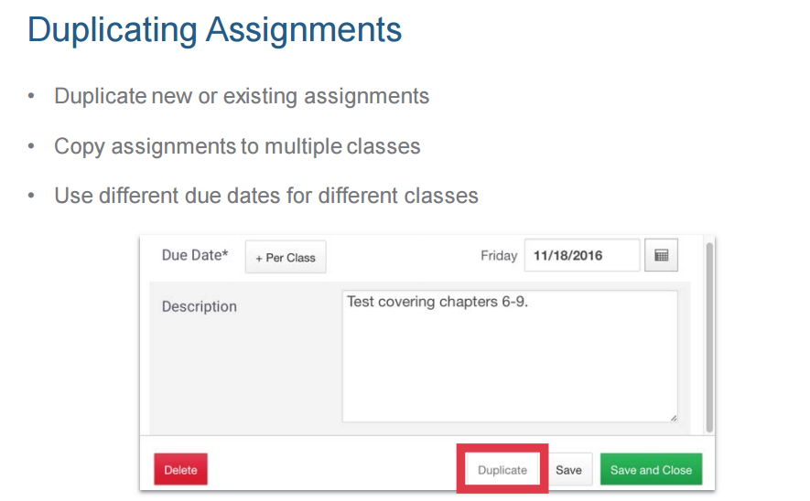
WE ARE Gaston County Schools
WE ARE Gaston County Schools

Slide 28
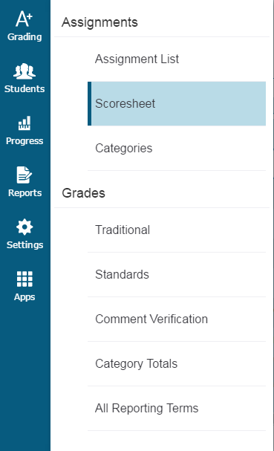
Assignment : Scoresheet
Notes:
Grades are for End of Term

Slide 29
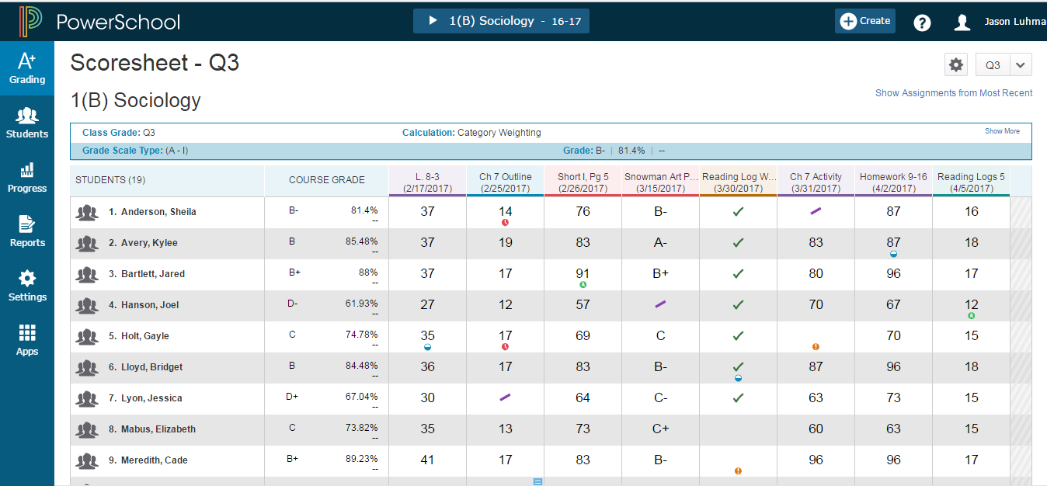
Score Sheet
Calculated final grade
Notes:
Scoresheet
-Grade column for final grade
-Can change view to show assignments from least recent
-will go into assignments with a click
-under gear you can see most recent first
On the charms bar, select Grading, and then select Scoresheet.
Select Show Assignments from Most Recent to sort assignments by date.
To view the scoresheet for a group of classes, choose the group from the Class Selector, then use the Scoresheet Quick Menu to easily switch between the classes within the group.

Slide 30
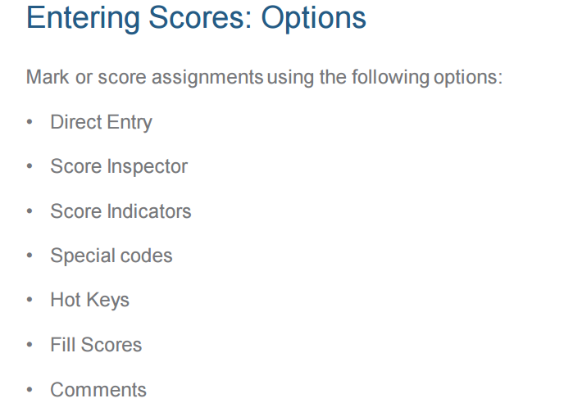
Working With Grades/Scores
WE ARE Gaston County Schools

Slide 31
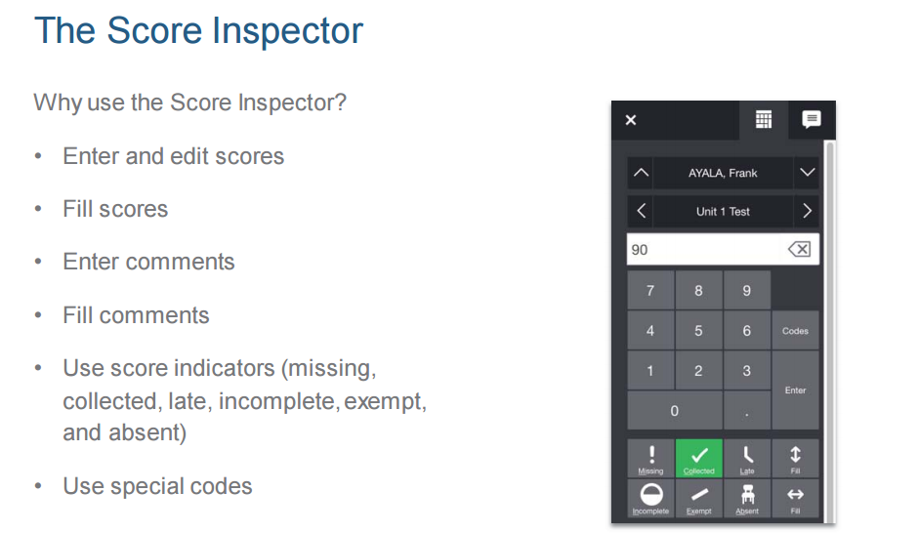
WE ARE Gaston County Schools

Slide 32
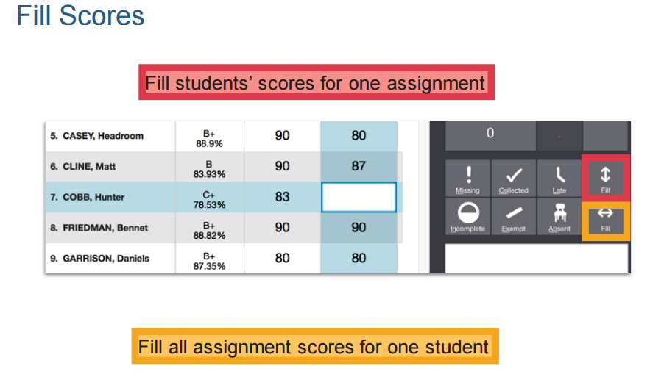

Slide 33
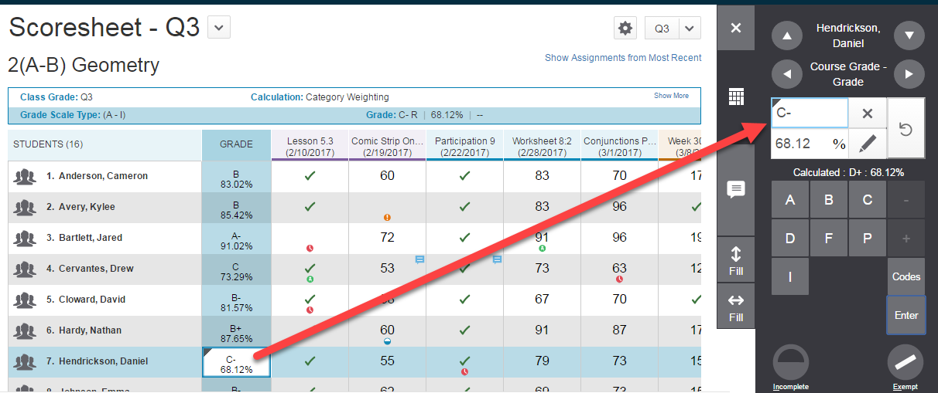
Score Assignments
override triangle
Notes:
Locate the assignment you want to score, and enter the students’ assignment scores in the Score column.
If standards are aligned to the assignment, enter the standards scores in the standards columns. Use the arrow keys on your keyboard or the arrows at the top of the Score Inspector to move to different score cells.
To change the term, make a selection from the Reporting Term menu in the upper right portion of the page.
Use the summary area to view details or make changes to an assignment.
Select the assignment name in the column heading to view a single assignment on the Scoresheet.
If you want to see more students on this page, use the View selector.
Select Save when you are done entering scores.
If the letter grade is manually overwritten the percentage is NOT automatically changed ... it must be manually changed separately.

Slide 34
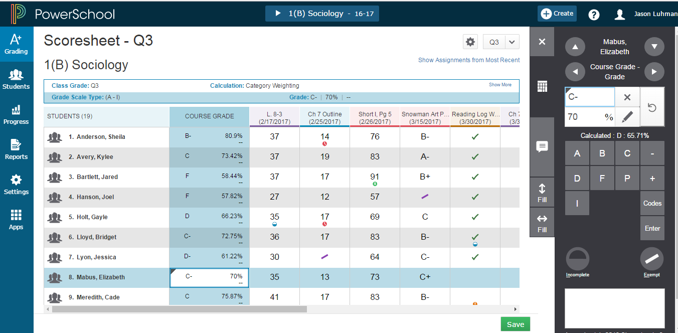
Changed Grade Tag
Notes:
-tag will appear for changed grade
-report comments will appear on this column

Slide 35
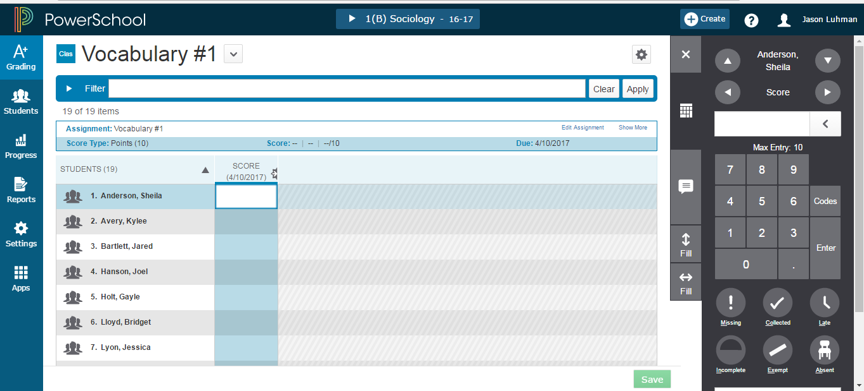
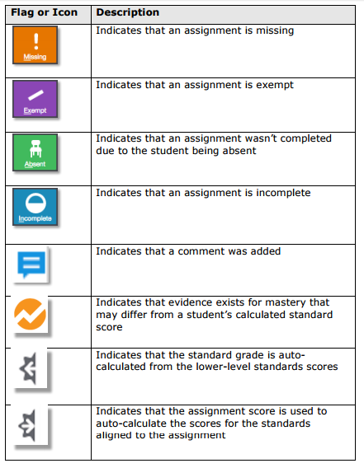
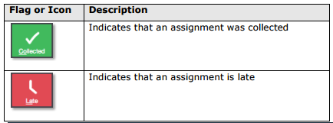
Assignments Flags
Notes:
Will push grade to future grade if this assignment on standards
-show how ‘tag’ functionality
-edit assignment -show more: get to SPECIAL Codes
-score indicators (missing, collected, late, etc..) -exempt-purple slash in box
-if there is a grade, the grade will appear in purple if exempt -can put in “hot keys” with letters
-score inspector (icon that looks like calculator) -comment
** NC Traditional Report Cards pull from one term only! Remember this and train teachers which term to enter their comments in if it needs to show on the NC Traditional Report Card.

Slide 36
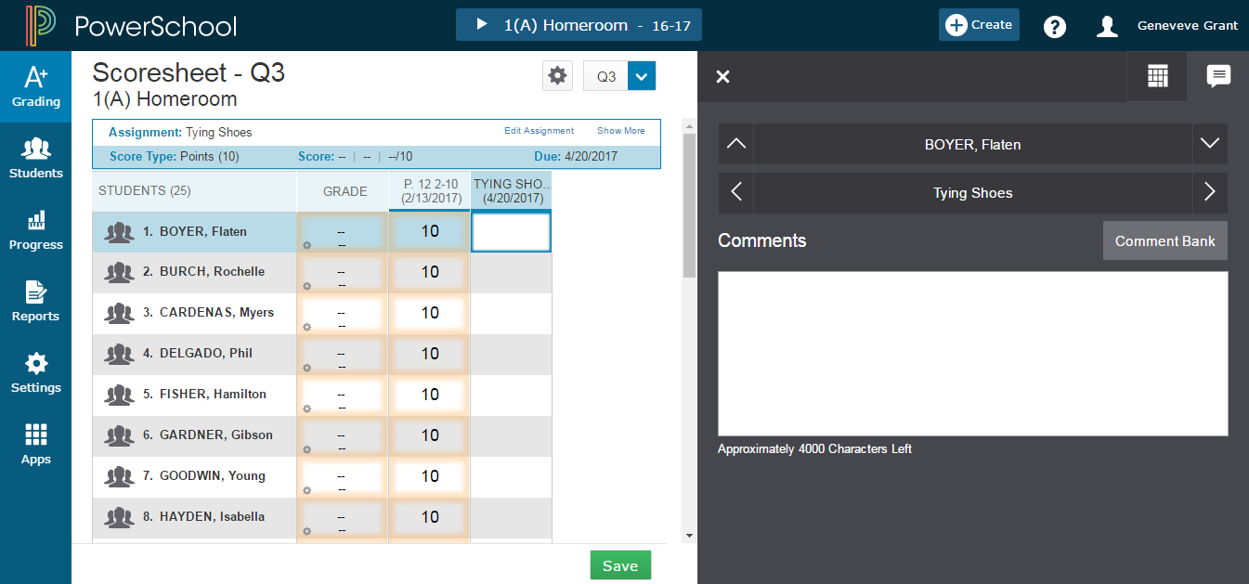
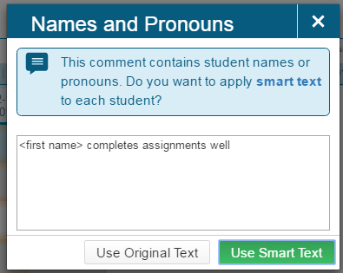
Scoresheet Comments and Smart Text Fill
Gear in lower left of Grade means a standard grade was manually overridden
Notes:
Note: little gear in lower left of Grade means a standard grade was manually overridden
Can access district comment bank
-can favorite comments
-special codes can be create by the district
To enter comments manually:
Select the text field at the bottom of the Score Inspector, or select the Comment icon on the Score Inspector and select the larger text field.
Enter comment text. A comment icon appears in the table for the selected field, indicating that a comment exists for that score or grade.
To select comments from the Comment Bank:
Select the Comment icon on the Score Inspector.
Select the Comment Bank button.
To limit the comments that appear in the Comment Bank, enter information in the Filter field and then select Apply.
Select the star next to a comment in the bank to set it as one of your favorite comments. You can then sort the list to display your favorite comments at the top of the list.
Select the checkbox next to one or more comments you want to add to the score.
Choose if you want comments separated by a line break or a space.
Select Insert Comments. A blue Comment icon appears in the student’s score cell. Click the icon to read the comment.

Slide 37
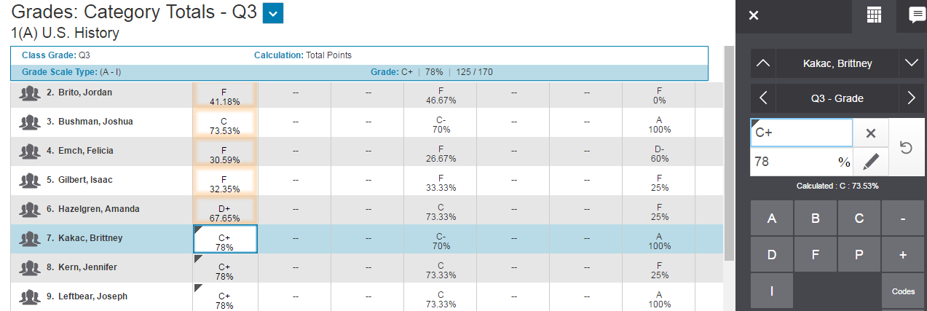
Working with Final Grades
Notes:
circly arrow takes out override traingle on final grade calculation, returns the original calculation and leaves a pink box outline, pink box outline goes away when page is saved

Slide 38
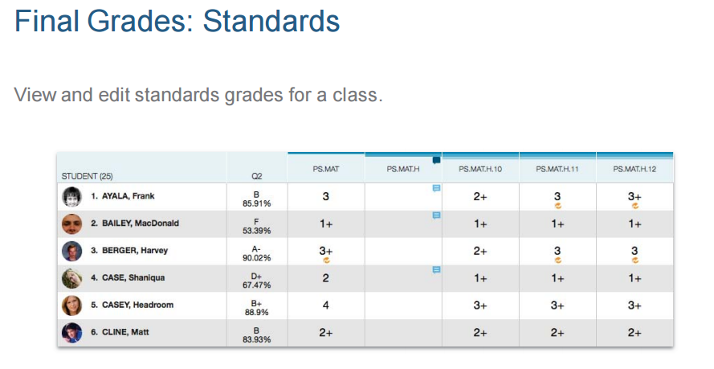
Grades K-2 Final Grades

Slide 39

Grades 3-12 Final Grades

Slide 40


Slide 41


Slide 42

Grades 3-12 Individual Student Progress

Slide 43


Grades K-2 Individual Student Progress

Slide 44


Progress > Traditional Grades Progress
The Traditional Grades Progress screen provides a graphical view of the grade distribution across the selected class.
The column on the left lists the number of students who have earned each traditional grade in the grade scale. The colors in the graph correspond to the grade scale color levels. To the right of the graph, view a summary of the total number of students who have missing, late, or incomplete assignments.
Notes:
Colors
-demarkation line: those progressing vs those not
-red-bad, green-good.
-click on bar graph to see grade distribution
-can select sections to compare (S1, S2)
The graph on the Traditional Grades Progress page shows the distribution of grades for the class for the selected reporting term. It also shows the aggregate totals for missing, late, or incomplete assignments.
On the charms bar, select Progress and then choose Traditional. The class grades progress appears in a graph.
Use the class selector to change to a different class, or to select a class group.
Select Missing, Late, or Incomplete to view the Traditional Grades page with summary information on each category.
Select the progress graph to view the Traditional Grades Distribution screen.
Select and then select the Show Trend box. Deselect the Show Trend box to hide the trend column. Select the term you want to compare against. If you are working with multiple classes, you can select if you want the class grouped by student or by class on this screen.
Select a Score Distribution chart to view the final grades and trend comparison. Arrows indicate if the grades are trending up or down against the selected comparison term.
Select OK to close the screen.
The Traditional Grades Progress screen provides a graphical view of the grade distribution across the selected class.
The column on the left lists the number of students who have earned each traditional grade in the grade scale. The colors in the graph correspond to the grade scale color levels. For example, if the grade scale defines the grades A and A- as dark green, the graph displays a dark green bar that corresponds to the number of students who have an A or A-. The black demarcation line shows where the cutoff is between passing and failing grades. The numbers in the column on the right show the total number of students who have passing grades versus the total number of students who have failing grades.
To the right of the graph, view a summary of the total number of students who have missing, late, or incomplete assignments.

Slide 45

Grades K-2 Class Progress

Slide 46

Grades K-2 Grade Distribution

Slide 47

Grades 3-12 Class Progress

Slide 48

Grades 3-5 Grade Distribution

Slide 49

Reports
Working with Reports
PowerTeacher Pro offers a selection of reports to assist you in daily classroom activities, as well as with assessing student performance. You can generate reports for all students who are enrolled in a class, for all students who are enrolled in all your classes, or for specific students.
Individual Student Report
Multi-Function Assignment Report Scoresheet Report
Student Roster Report
Notes:
Section Readiness Report is not available yet .... however, can use under A+ charm -> Grading -> Comment Verification --can be printed to hand in by the teacher to let office know they are done with their grades
Gradebook Preference under Students sort drop down means it will print the student’s preferred name but this functionality is not currently working as of 4/25/2017.

Slide 50
PowerTeacher Pro Resources
http://www.nc-sis.org/PTP.html
Notes:
Play video: Using PT Pro & Creating assignments

Slide 51
PowerTeacher Pro
Questions

